Slide 1




Build Ontology View on ArchiMate 3.2 Specification
001
Opening

Slide 2

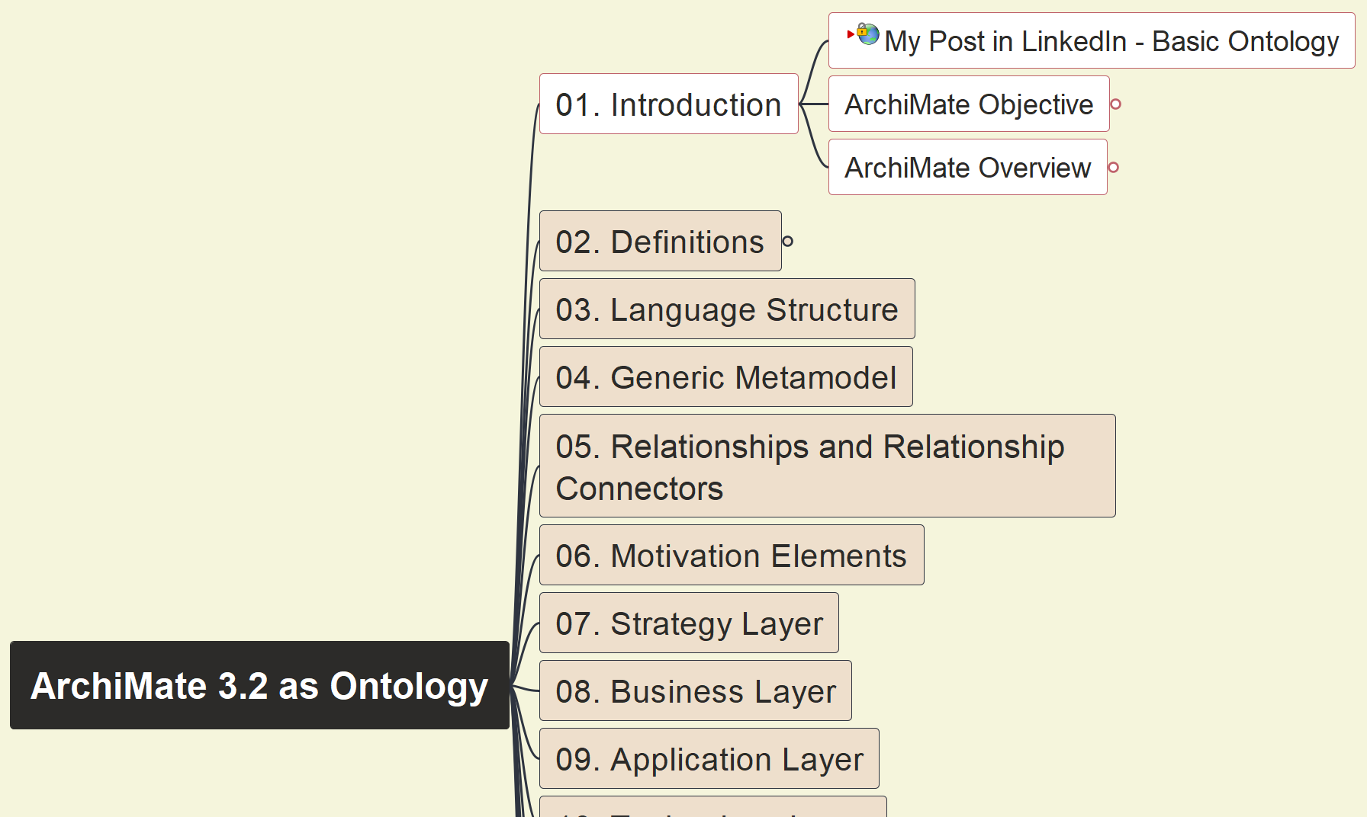
Build Ontology View on ArchiMate 3.2
002
ArchiMate Language Introduction

Slide 3
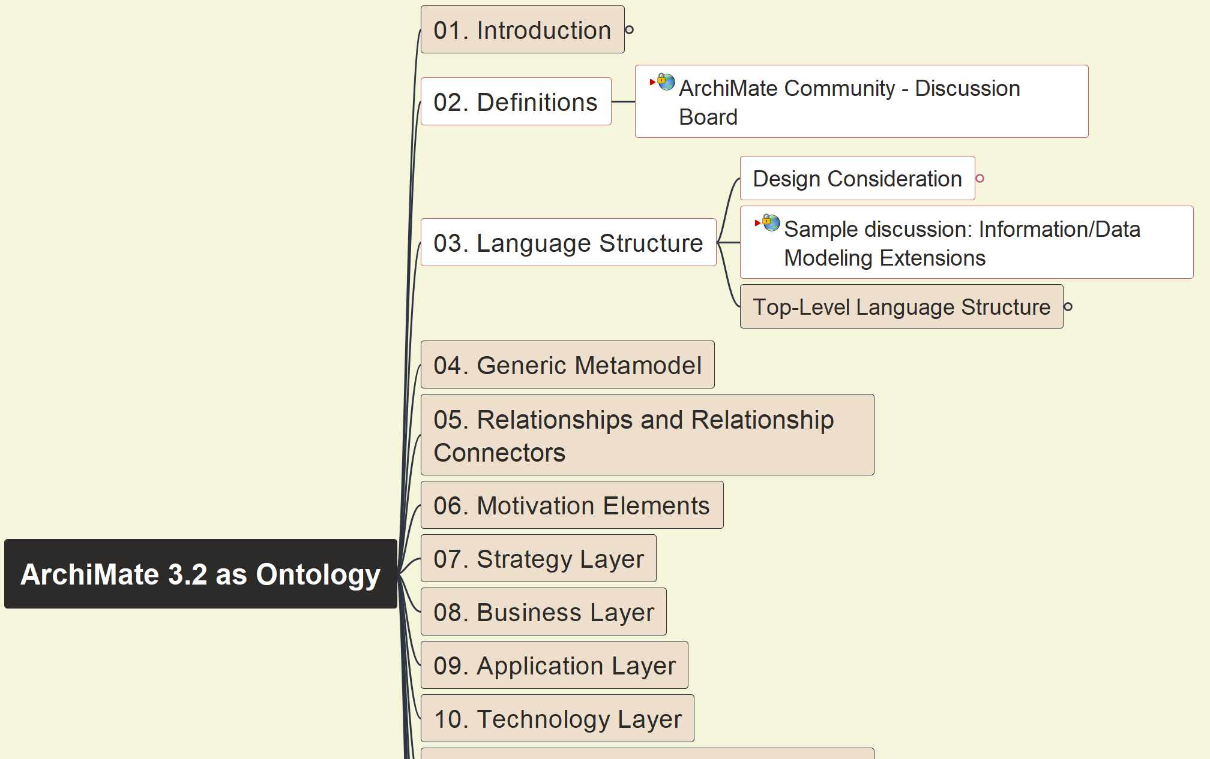
Build Ontology View on ArchiMate 3.2
003
ArchiMate Definition and Structure

Slide 4
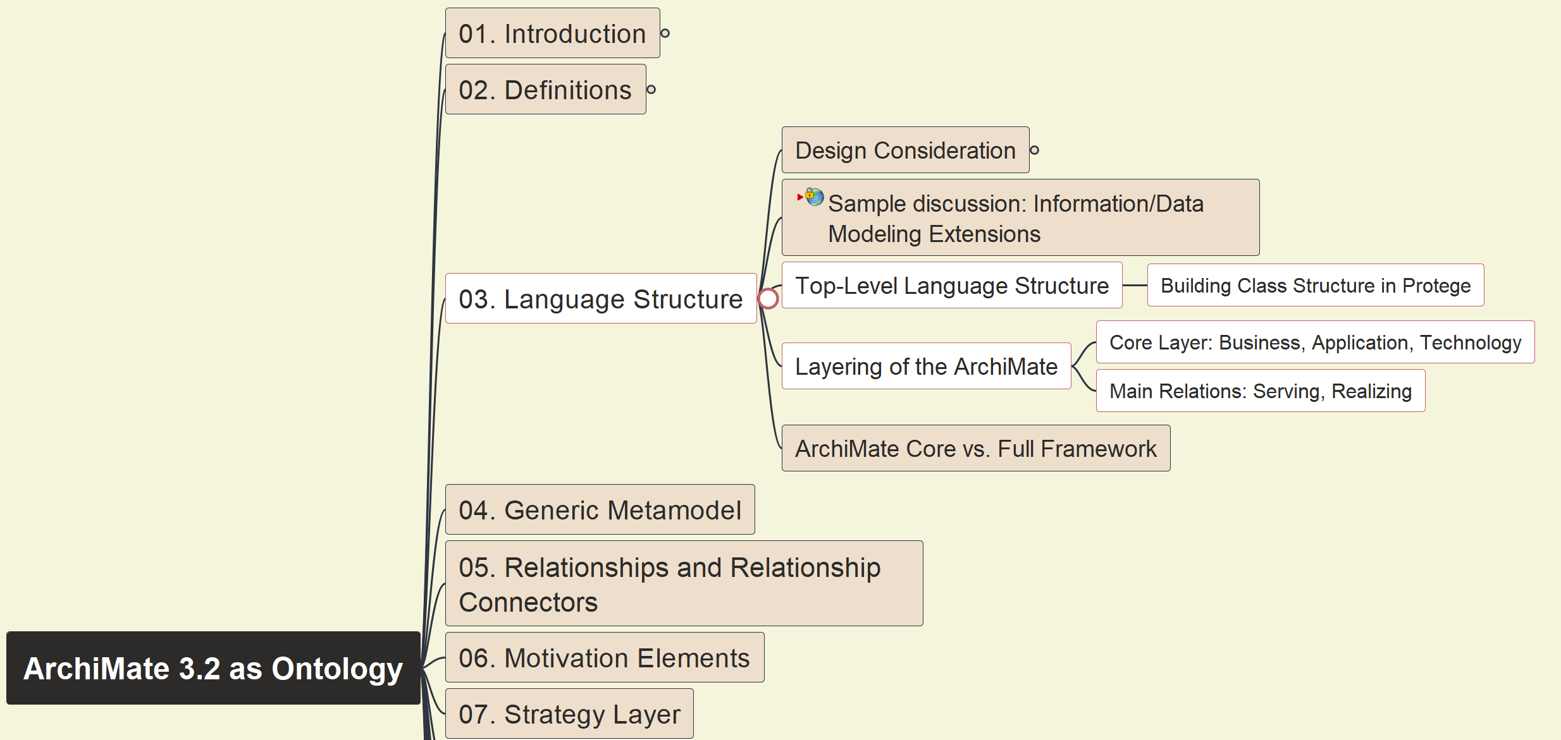
Build Ontology View on ArchiMate 3.2
004
ArchiMate Top-Level Structure - Layering

Slide 5
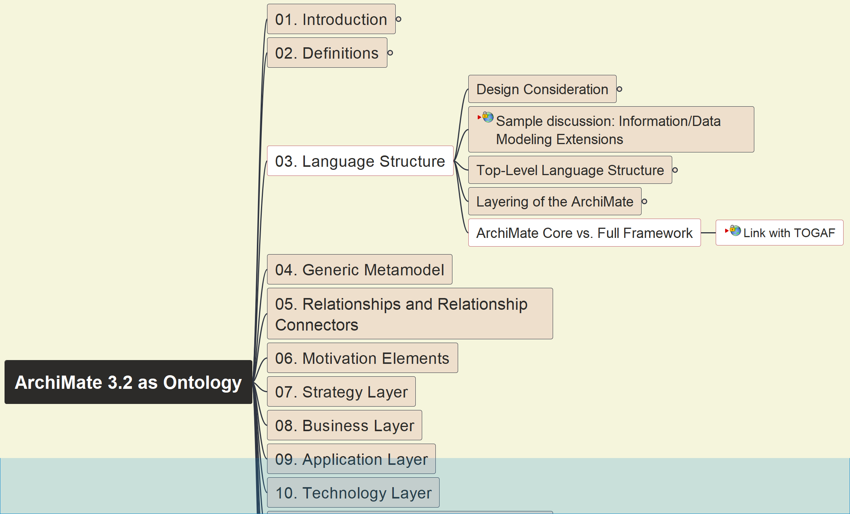
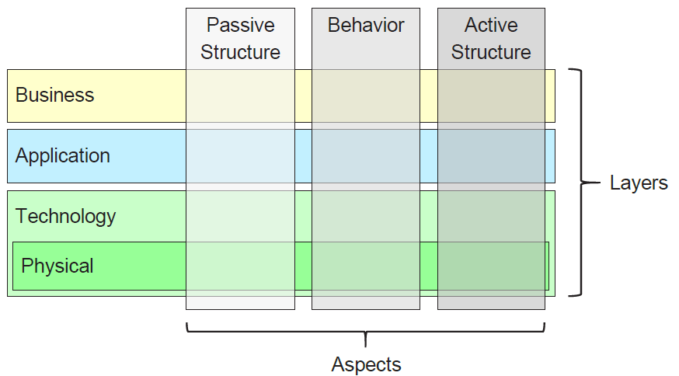
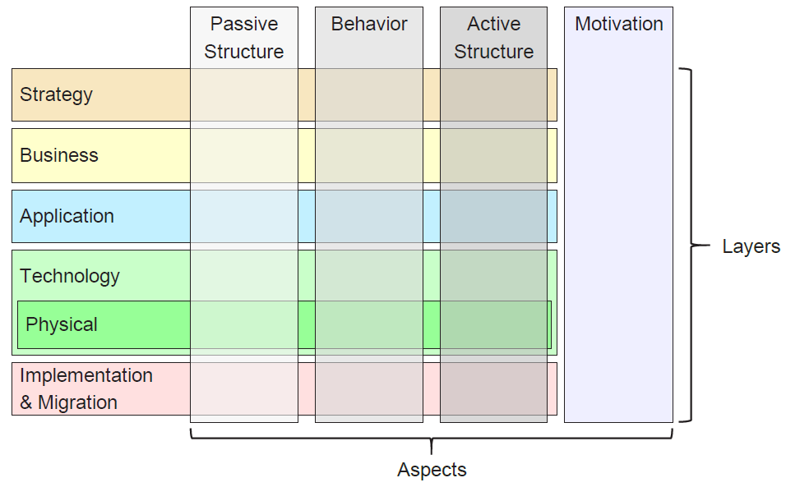
Build Ontology View on ArchiMate 3.2
005
ArchiMate Core vs. Full Framework

Slide 6
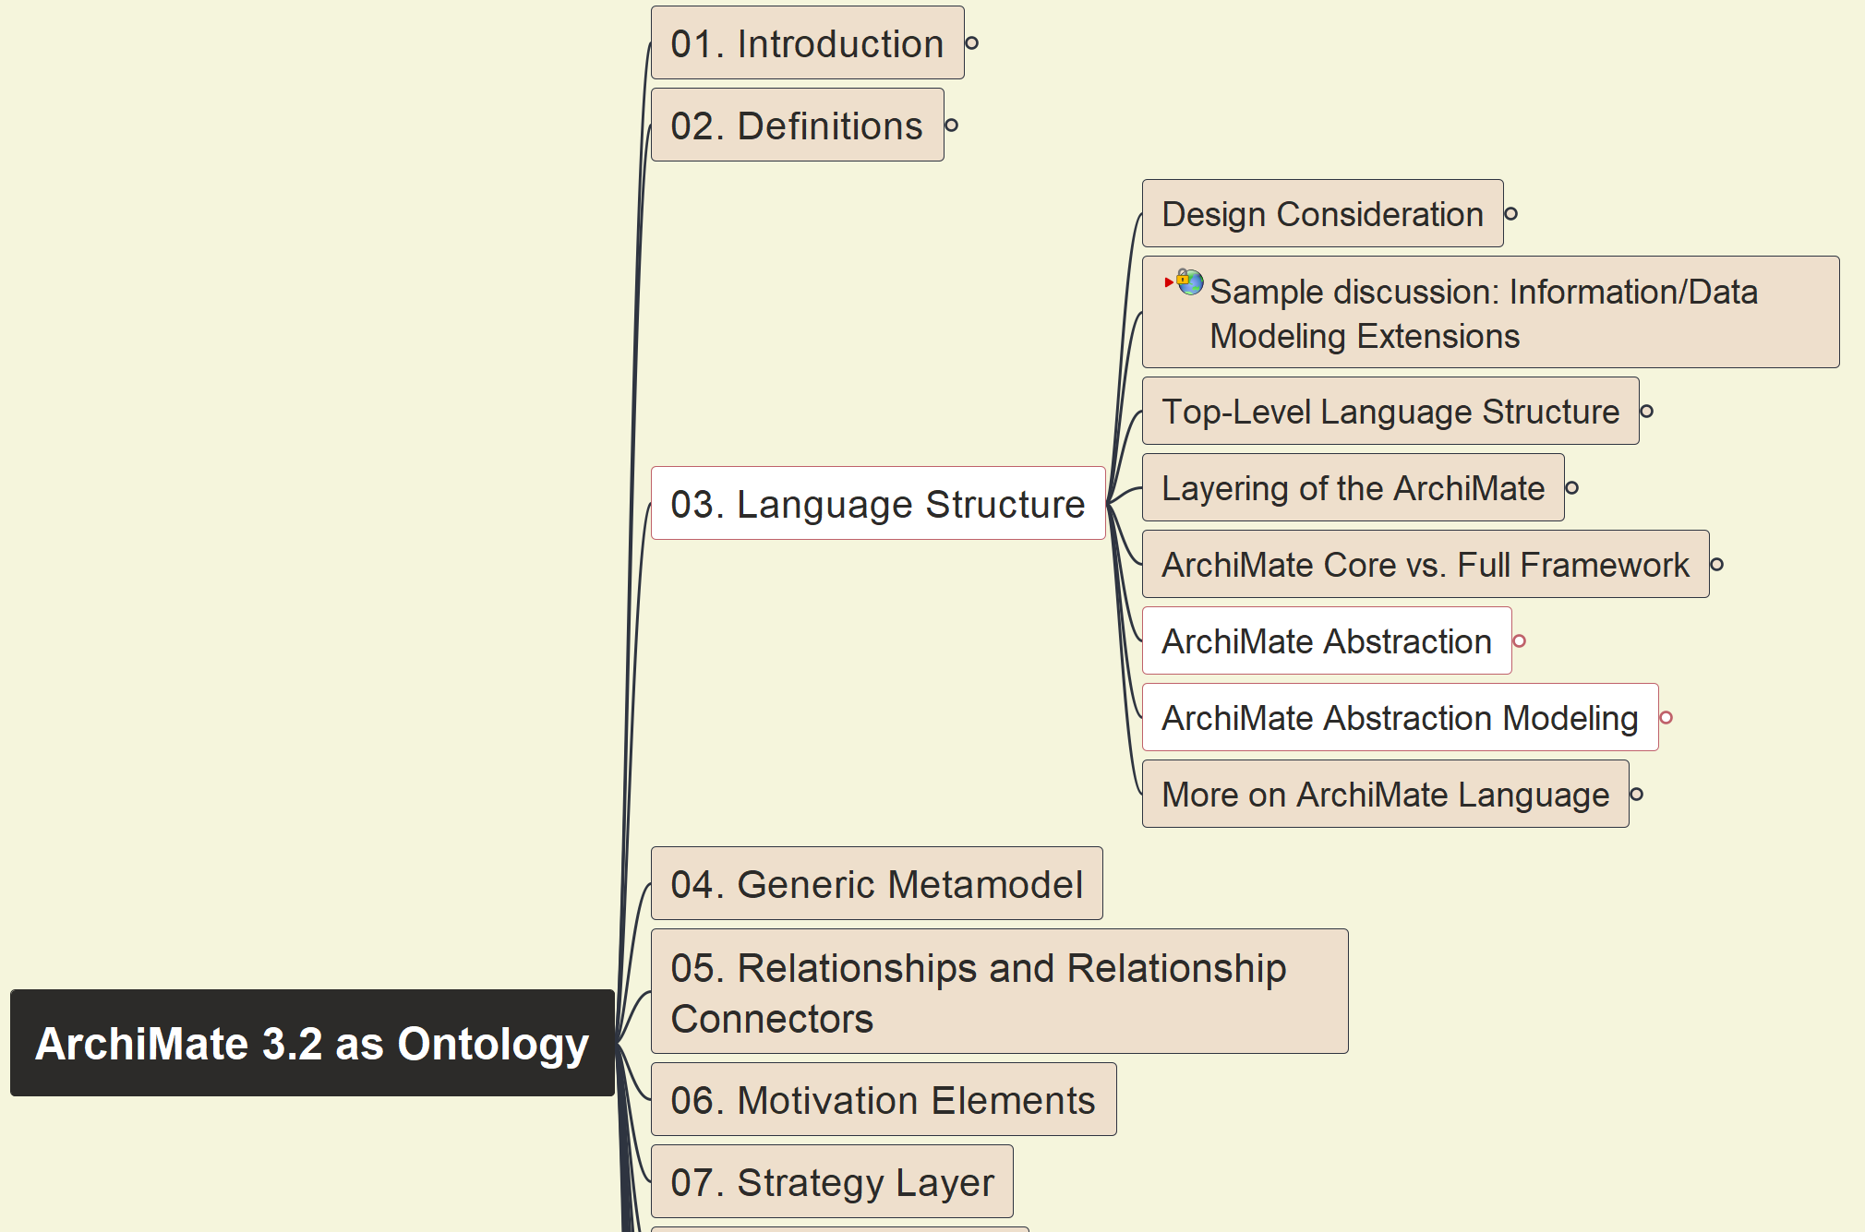
Build Ontology View on ArchiMate 3.2
006
ArchiMate Abstraction and Modeling

Slide 7
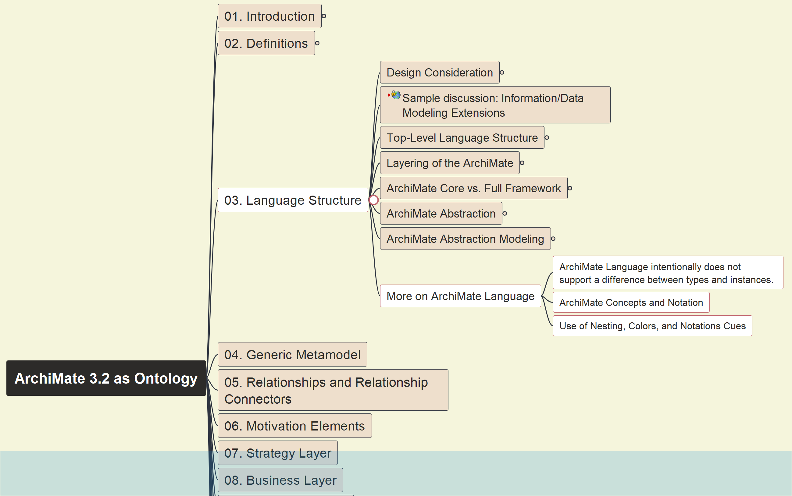
Build Ontology View on ArchiMate 3.2
007
More on ArchiMate Language Structure

Slide 8





